Slide 1

SOLAR-POWERED AUTOMATIC
DEWATERING SYSTEM
for Mining Operations Using IoT
Sanjivani College of Engineering
Department of Computer Engineering | S.Y. B.Tech | Div-A
Fundamentals of Internet of Things (MDCO223) | Academic Year 2025-26
GROUP MEMBERS
Thombare Hrushikesh | Waghmare Rutuja | Rajput Gayatri | Dhanapune Om

Slide 2
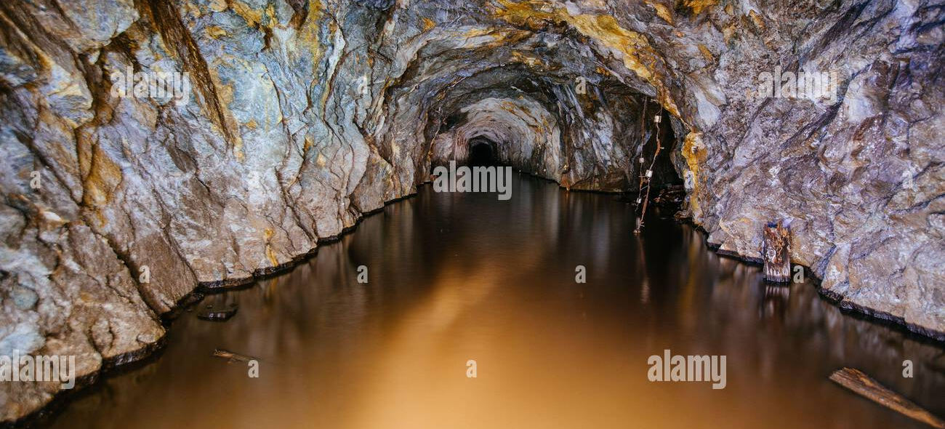
INTRODUCTION & PROBLEM STATEMENT
The Problem
Water ingress in underground and open-pit mines represents one of the most critical safety hazards in the mining industry worldwide.
Groundwater infiltration, surface runoff, and rainwater percolation create dangerous flooding conditions that endanger miners' lives.
Our Solution
Challenges with Current Systems
A solar-powered automatic dewatering system using Arduino UNO microcontroller with:
✓ Real-time water level monitoring
✓ Dual-threshold smart pump control
✓ 100% renewable solar energy powered
✓ Zero human intervention required
▶ High diesel fuel costs for remote mine sites
▶ Carbon emissions violating environmental regulations
▶ Frequent maintenance and skilled operator requirements
▶ Risk of human error in manual pump operation
▶ Delayed response can cause catastrophic consequences
02

Slide 3
PROJECT OBJECTIVES
Water Level Monitoring
Solar-Powered Operation
Automatic Pump Control
Automatic real-time detection of water accumulation using analog water level sensor connected to Arduino pin A0
Complete energy independence using 12V solar panel with PWM charge controller and sealed lead-acid battery
Smart relay-based pump activation using dual-threshold hysteresis logic with confirmation filter
Reduce Human Intervention
Energy-Efficient System
Real-Time IoT Display
24/7 autonomous operation with minimal supervision, eliminating manual pump switching and human error risks
Sustainable design with zero fuel cost, low carbon footprint, and minimal maintenance requirements
I2C LCD display and serial monitor provide continuous visual feedback of water level and pump status
03

Slide 4
SYSTEM ARCHITECTURE
Complete signal and power flow diagram
POWER FLOW
☀
Solar Panel
12V / 20W
Charge
Controller
PWM
🔋
Battery
12V / 7Ah SLA
Buck
Converter
LM2596 12V→5V
◈
Arduino UNO
ATmega328P
Relay
Module
5V Active LOW
DATA FLOW
Water Level
Sensor
Analog A0
◈
Arduino UNO
Processing
I2C Bus
LCD
Display
16x2 I2C
Submersible
Pump
12V DC Motor
0-1023 ADC
Serial Monitor
9600 baud
Control Thresholds
Timing Parameters
Confirmation Filter
HIGH_THRESHOLD = 700 → Pump ON
LOW_THRESHOLD = 300 → Pump OFF
Hysteresis Band: 400 units
Sample: 10 readings × 50ms delay
Cycle Interval: 2000ms
Confirm Filter: 3 cycles (6s)
3 consecutive consistent readings
required before pump state change
Eliminates false triggering from noise
04

Slide 5
COMPONENTS USED
Arduino UNO
Water Level Sensor
Relay Module
LCD Display
ATmega328P microcontroller
16MHz | 32KB Flash | 2KB SRAM
Role: Central processing unit, sensor reading, pump control logic
Analog resistive sensor
Output: 0-5V (0-1023 ADC)
Role: Detects water accumulation level in mine pit via pin A0
5V single-channel relay
Active LOW logic | Optocoupler
Role: Electrical isolation between Arduino and pump motor
16×2 I2C LCD Module
PCF8574 backpack | Addr 0x27
Role: Real-time on-site display of water level and pump status
Solar Panel
Battery
Buck Converter
Submersible Pump
12V / 20W Monocrystalline
15-20% conversion efficiency
Role: Primary renewable energy source for off-grid operation
12V 7Ah Sealed Lead-Acid
Deep cycle rechargeable
Role: Energy storage for continuous 24/7 system operation
LM2596 DC-DC Step Down
12V → 5V regulated output
Role: Voltage regulation for Arduino and peripheral modules
12V DC Motor Pump
500-2000 L/hr flow rate
Role: Physical water removal from mine pit to safe discharge
05

Slide 6
WORKING PRINCIPLE
Six-stage automated operational cycle
01
System Startup
02
Water Level Monitoring
03
Threshold Evaluation
Initialize Serial, I2C, LCD, relay pin. Display splash screen.
Read sensor A0 every 2s. Average 10 samples with 50ms delay.
Compare against HIGH=700 and LOW=300 thresholds.
06
Stable State Monitoring
05
Pump Control via Relay
04
Confirmation Filter
LCD and Serial display status. Loop back to Stage 2 after 2s.
Active LOW relay signal drives pump ON/OFF based on confirmed state.
Require 3 consecutive consistent readings over 6 seconds.
Continuous Loop
Sensor Reading Process
Pump Activation Logic
1. Call readAveragedSensor() function
2. Take 10 successive analog readings from A0
3. 50ms delay between each reading (500ms total)
4. Compute integer average of all samples
5. Return noise-filtered representative value
6. ADC range: 0-1023 (corresponds to 0-5V)
▸ Pump ON: Value > 700 (HIGH)
digitalWrite(relayPin, LOW)
LCD: "Pump: ON [wave]"
▸ Pump OFF: Value < 300 (LOW)
digitalWrite(relayPin, HIGH)
LCD: "Pump: OFF [sleep]"
06

Slide 7
ARDUINO LOGIC & SOFTWARE
DECISION LOGIC FLOW
SOFTWARE ARCHITECTURE
1. Read Sensor (10 samples)
Core Functions
2. Compare Thresholds
▸ setup() — Initialize Serial (9600), I2C, LCD, relay pin
▸ loop() — Main cycle every 2000ms
▸ readAveragedSensor() — 10-sample noise filter
▸ setPump(bool) — Active LOW relay control
▸ updateLCD() — Real-time status display
Value > 700 → HIGH
Value < 300 → LOW
Confirm HIGH
3 cycles (6s)
PUMP ON
Pin 8 = LOW
Confirm LOW
3 cycles (6s)
PUMP OFF
Pin 8 = HIGH
Wait 2s ↻
No Change (300-700)
Libraries Used
KEY PARAMETERS
▸ Wire.h — I2C communication protocol
▸ LiquidCrystal_I2C.h — LCD display control
HIGH_THRESHOLD = 700 → Pump activates
LOW_THRESHOLD = 300 → Pump deactivates
NUM_SAMPLES = 10 → Averaging window
SAMPLE_DELAY = 50ms → Between readings
CONFIRM_CYCLES = 3 → State change filter
CYCLE_INTERVAL = 2000ms → Main loop timing
Development Environment
▸ Arduino IDE 2.x
▸ Language: C++ (Arduino Framework)
07

Slide 8
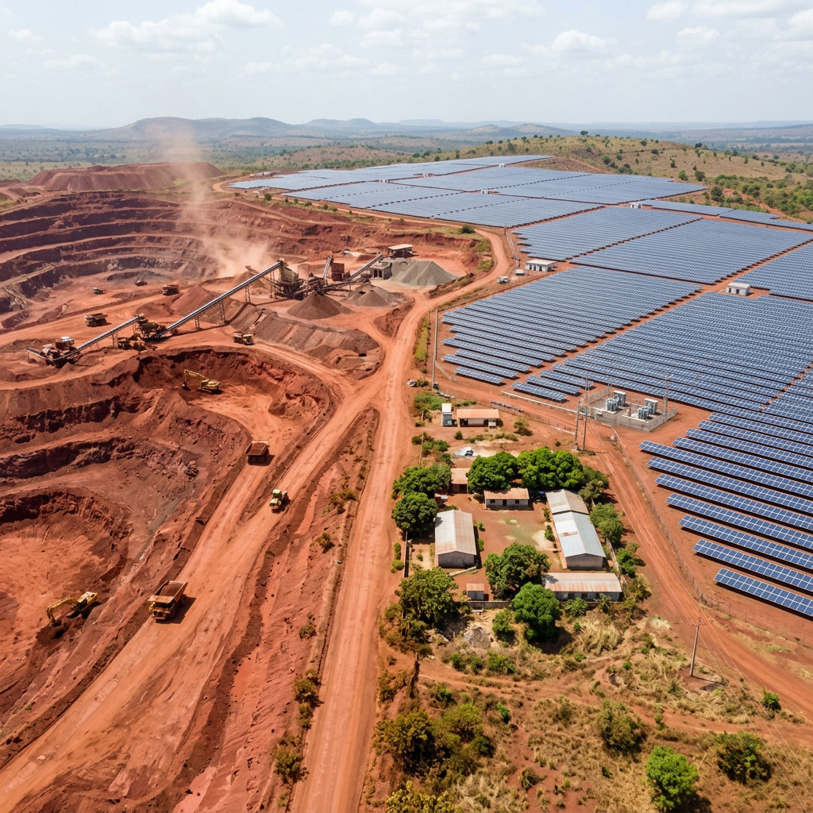
SOLAR POWER INTEGRATION
Renewable energy infrastructure for off-grid autonomy
ENERGY FLOW
KEY BENEFITS
Solar Panel
12V / 20W
Monocrystalline
Off-Grid Autonomy
Zero Fuel Cost
No grid electricity needed
Eliminates diesel fuel expenses
Charge Controller
PWM Type | 10A
Overcharge protection
Eco-Friendly
Protected Charging
Zero carbon emissions
Prevents overcharging and deep discharge
Battery
12V / 7Ah SLA
Deep cycle | LVD
24/7 Continuous Operation
Solar charges battery during daylight; battery powers system through night and cloudy periods
Buck Converter
LM2596
12V → 5V DC-DC
Arduino UNO
5V Regulated Supply
08

Slide 9
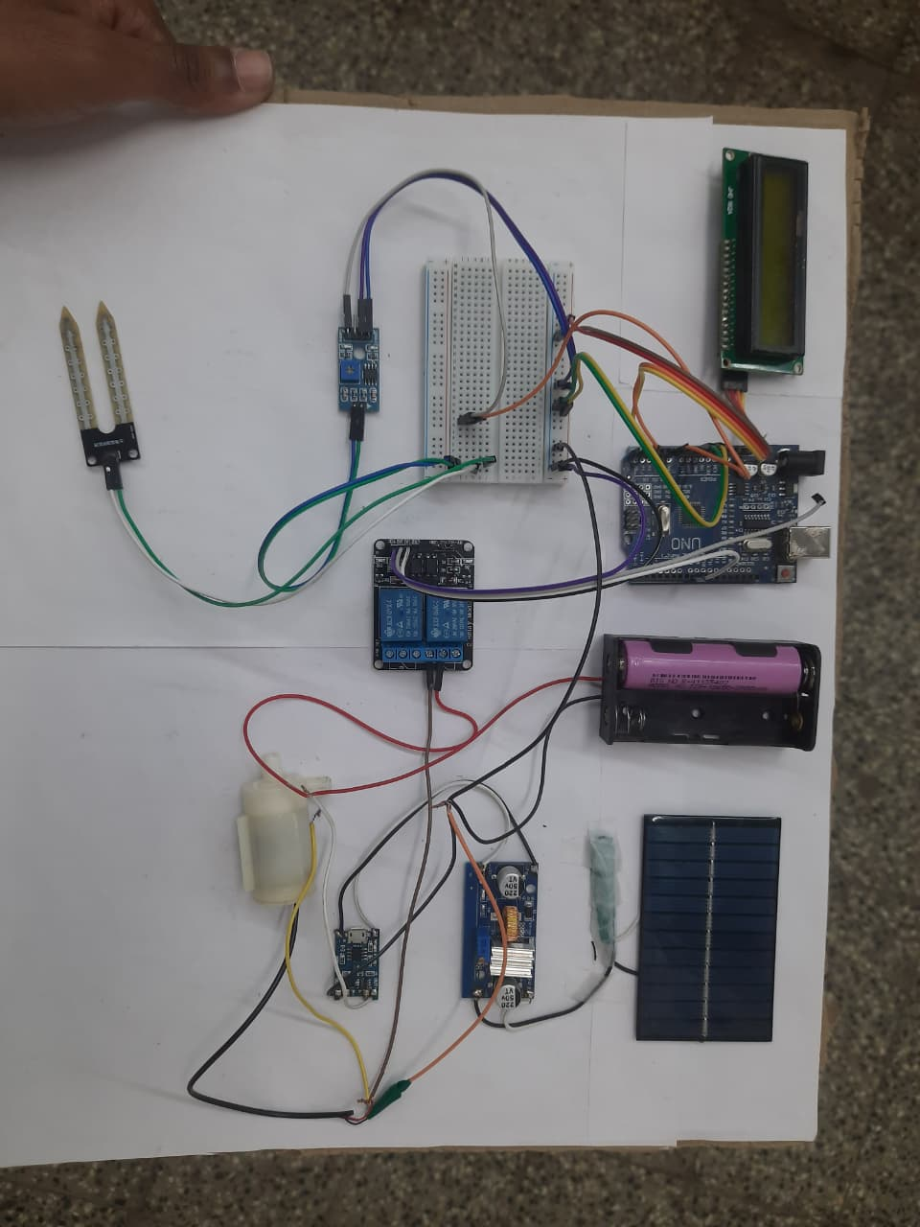
HARDWARE IMPLEMENTATION
Actual project prototype with all components assembled
COMPONENT LABELS
Arduino UNO
LCD Display
Water Sensor
Relay Module
Solar Panel
Battery
Submersible Pump
Buck Converter
Implementation Summary
▸ Standalone embedded hardware platform
▸ Solar power + battery energy storage
▸ Water level sensing + auto pump control
▸ I2C LCD for on-site visual monitoring
▸ Serial output for remote diagnostics
▸ Breadboard-based modular assembly
▸ All connections using jumper wires
09

Slide 10
OUTPUT & RESULTS
System testing and validation results
OUTPUT 1
System Startup
OUTPUT 2
Pump Idle (Water LOW)
OUTPUT 3
Confirmation Filter
Solar Dewatering
Initialising..
Serial:
=== Solar Dewatering
System Ready ===
Pump: OFF [sleep]
Water:245 LOW
Serial:
Water Level: 245 → LOW
Pump idle...
Pump: OFF [sleep]
Water:723 [1/3]
Serial:
Confirming... (1/3)
→ (2/3) → (3/3)
OUTPUT 4
Pump Active (Water HIGH)
OUTPUT 5
Water Falls - Pump OFF
Pump: ON [wave]
Water:715 HIGH
Serial:
>>> Pump ON (Water HIGH)
Pump running...
Pump: OFF [sleep]
Water:261 LOW
Serial:
>>> Pump OFF (Water LOW)
Pump idle...
TEST SUCCESSFUL
Automatic dewatering demonstrated successfully with accurate threshold-based pump control
Testing Summary
✓ System initialized correctly with splash screen display ✓ Accurate water level readings (0-1023 ADC range)
✓ Confirmation filter successfully prevents false triggering (3 cycles) ✓ Pump activates at HIGH threshold (700) and deactivates at LOW (300)
✓ LCD displays real-time status with custom icons ✓ Serial monitor provides complete operational logging
10

Slide 11
ADVANTAGES & APPLICATIONS
ADVANTAGES
APPLICATIONS
Low Cost
Mining Operations
Affordable components with minimal operational expenditure compared to diesel systems
Underground and open-pit mine dewatering
Automatic Operation
Construction Sites
24/7 autonomous monitoring and control with zero human intervention required
Foundation pit and excavation dewatering
Renewable Energy Based
Solar-powered with zero carbon emissions and no fossil fuel dependency
Water Drainage Systems
Flood control and storm water management
Reliable & Safe
Confirmation filter eliminates false triggers; relay provides electrical isolation
Underground Tunnels
Subway and tunnel water ingress management
Low Maintenance
Minimal moving parts; solar panels require only occasional cleaning
Smart Irrigation
Automated agricultural water management
11

Slide 12
CONCLUSION & FUTURE SCOPE
CONCLUSION
FUTURE SCOPE
Mobile App Monitoring — Remote control via smartphone application
Project Successfully Completed
GSM/WiFi Alerts — SMS and email notifications for critical events
✓ Successfully automates mine dewatering operations
✓ Solar-powered sustainable and eco-friendly solution
✓ Reliable pump control using Arduino with IoT concepts
✓ Dual-threshold logic with confirmation filter works effectively
✓ Real-time monitoring via LCD and serial interface
✓ Eliminates dependency on fossil fuels and manual labor
Cloud-Based IoT Dashboard — Real-time data visualization and analytics
AI-Based Predictive Monitoring — Machine learning for failure prediction
THANK YOU
Questions & Discussion
Sanjivani College of Engineering | Computer Engineering
Group 8 | Fundamentals of IoT (MDCO223)

